Slide 1

Practical AI in Language Learning: Tools for Italian Studies
SIS Conference Digital Lab
University of Leeds
24th June 2025
Joe Dale
joedale@talk21.com

Slide 2

Introduction to AI in Language Education:
This practical session introduces a suite of AI tools that are accessible, free (or freemium), and adaptable for Italian language teaching, research transcription, and assessment. Each demonstration will be accompanied by real-world examples and time for brief participant exploration or discussion. Feel free to observe, try out tools live, or work in pairs.

Slide 3

How AI savvy are you?:
1: New to AI, with no prior experience using these tools.
2: Has basic knowledge and has experimented with some AI tools
3: Frequently uses AI tools for tasks such as lesson planning and resource creation.
4: Integrating AI tools seamlessly into teaching with strong prompt engineering skills.

Slide 4

Enhancing Listening and Speaking with AI Tools

Slide 5

Suno:
Pronunciation: Realistic AI voices for accurate pronunciation.
Custom Content: Tailored audio for diverse contexts.
Listening: Varied voices to build comprehension skills.
iOS and Android apps now available
https://suno.com

Slide 6

Mizou:
• Custom multilingual Chatbots
• Suitable for all students in educational settings under teacher supervision
• Facilitates creation of real-world conversational scenarios
• Enhances speaking practice with scenario-based interactions
• Interactions are privately shared with the teacher managing the chatbot
https://mizou.com

Slide 7

Enhancing Reading and Research with AI Tools

Slide 8

Diffit:
Creates graded versions of different texts in different languages
Enables the creation of tailored language exercises and quizzes.
Allows for YouTube clips and PDFs to be turned into listening and reading comprehension activities.
Export content to Google Docs, Forms or Slides (Premium)
https://beta.diffit.me

Slide 9

Turboscribe:
Converts audio and video into text, ensuring accurate and reliable transcription for analysis or accessibility.
Use Cases: Research interviews, field recordings, CPD events
Supports over 98 languages, accommodating diverse linguistic needs and enhancing global learning.
Offers various transcript formats, including subtitles and captions,
https://turboscribe.ai

Slide 10

AI for Assessment and Feedback

Slide 11

Brisk:
Generate Google Slides from a web page
Create Google Quizzes from a Google Doc or web page
Provide Feedback in a Google Docs
Produce graded versions of text
https://chromewebstore.google.com/detail/brisk-teaching/pcblbflgdkdfdjpjifeppkljdnaekohj

Slide 12

MS Forms Prompt:
Quickly generates multiple-choice quizzes with correct answers indicated.
Creates Word documents pre-formatted for seamless Microsoft Forms import.
Automates self-marking quiz setup with minimal effort.
Saves time and streamlines quiz creation for educators.
https://docs.google.com/document/d/1mSn_OAA_PtBBrGGf0khTN39rC5R5SfqYYQezXPi0lGo/edit?usp=sharing

Slide 13
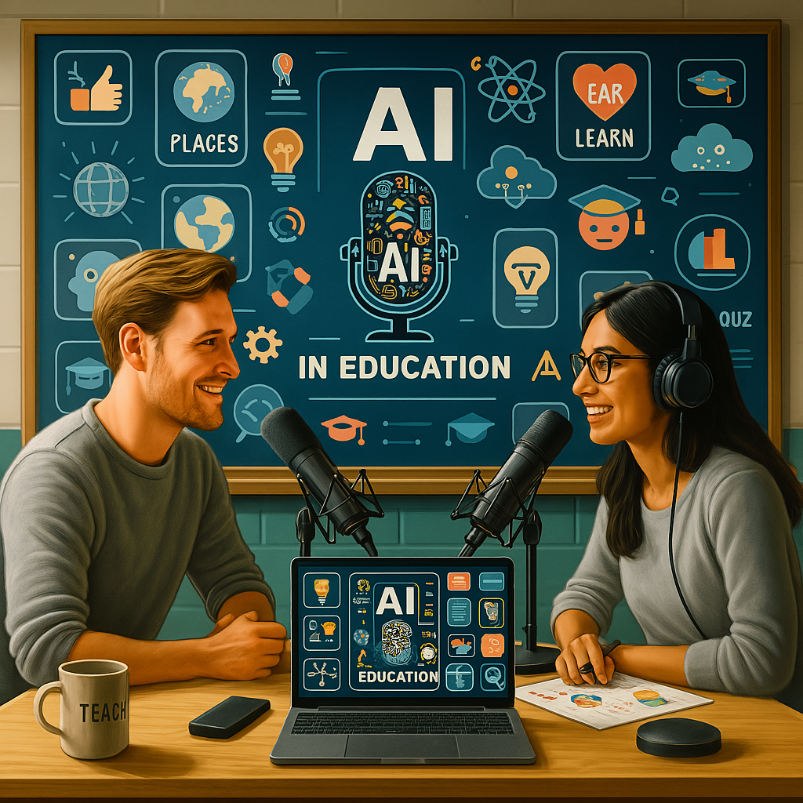
Brisk Podcasts:
Turn any webpage, Google Doc, or Slide into a podcast
Create short audio dialogues in multiple languages
Use Boost to add interactive comprehension tasks and chatbot support
Generate transcripts to create vocabulary, grammar, and speaking activities
https://chromewebstore.google.com/detail/brisk-teaching/pcblbflgdkdfdjpjifeppkljdnaekohj

Slide 14
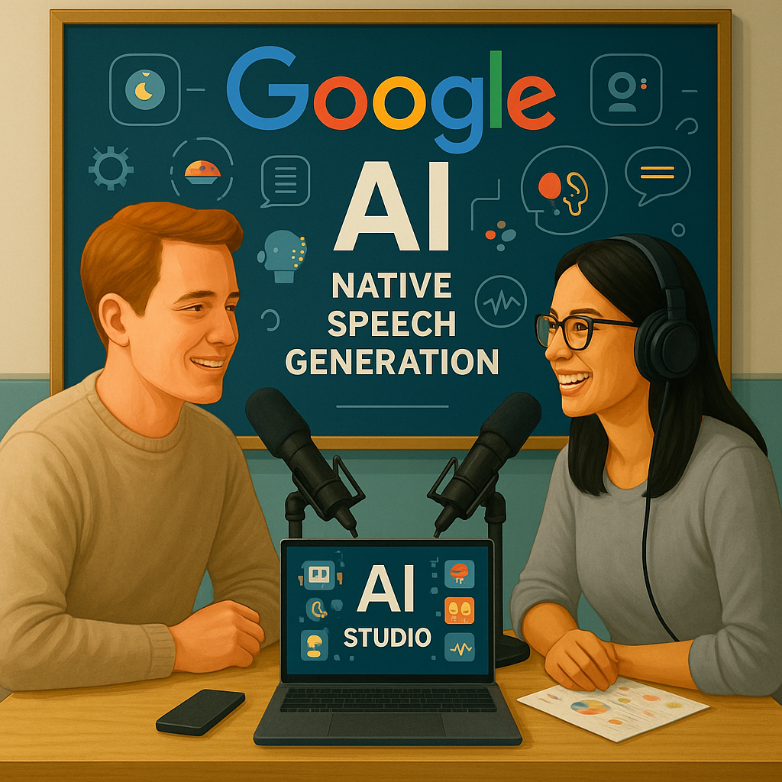
Google AI Studio:
Select the Native speech generation tool.
Write a dialogue script, labeling each speaker.
Assign different AI voices to each speaker.
Generate and download the audio with both voices.
https://aistudio.google.com/generate-speech

Slide 15

NotebookLM:
Generate engaging audio summaries of lesson content or reading materials for students.
Provide personalised feedback on assignments in the form of a podcast-style discussion.
Enhance accessibility by offering alternative learning formats through audio-based content.
https://notebooklm.google.com

Slide 16
Conclusion:

Slide 17

Language Teaching with AI:
Facebook group run by Joe Dale
Over 5800 members
A great place to share and learn with other language teachers!
https://www.facebook.com/groups/languageteachingwithai

Slide 18
Language Teaching with AI: webinar series (2026 Edition)
4 recorded webinars
Enhancing Listening, Speaking, Reading & Writing
Nearly 500 teachers trained worldwide
Buy 4 webinars for the price of 3
Full presentation slides
Certificates of attendance available
Departmental licences available
6 hours of training
https://bit.ly/ltwajoedale

Slide 19

Language Teaching with AI: webinar series
4 part webinar series
Around 150 language teachers have already registered since November 2024
6 hrs of recordings, 4 presentations and certificates available
Buy 3 get 1 FREE plus departmental rates
Pay by invoice
https://bit.ly/languageteachingwithaijoedale

Slide 20
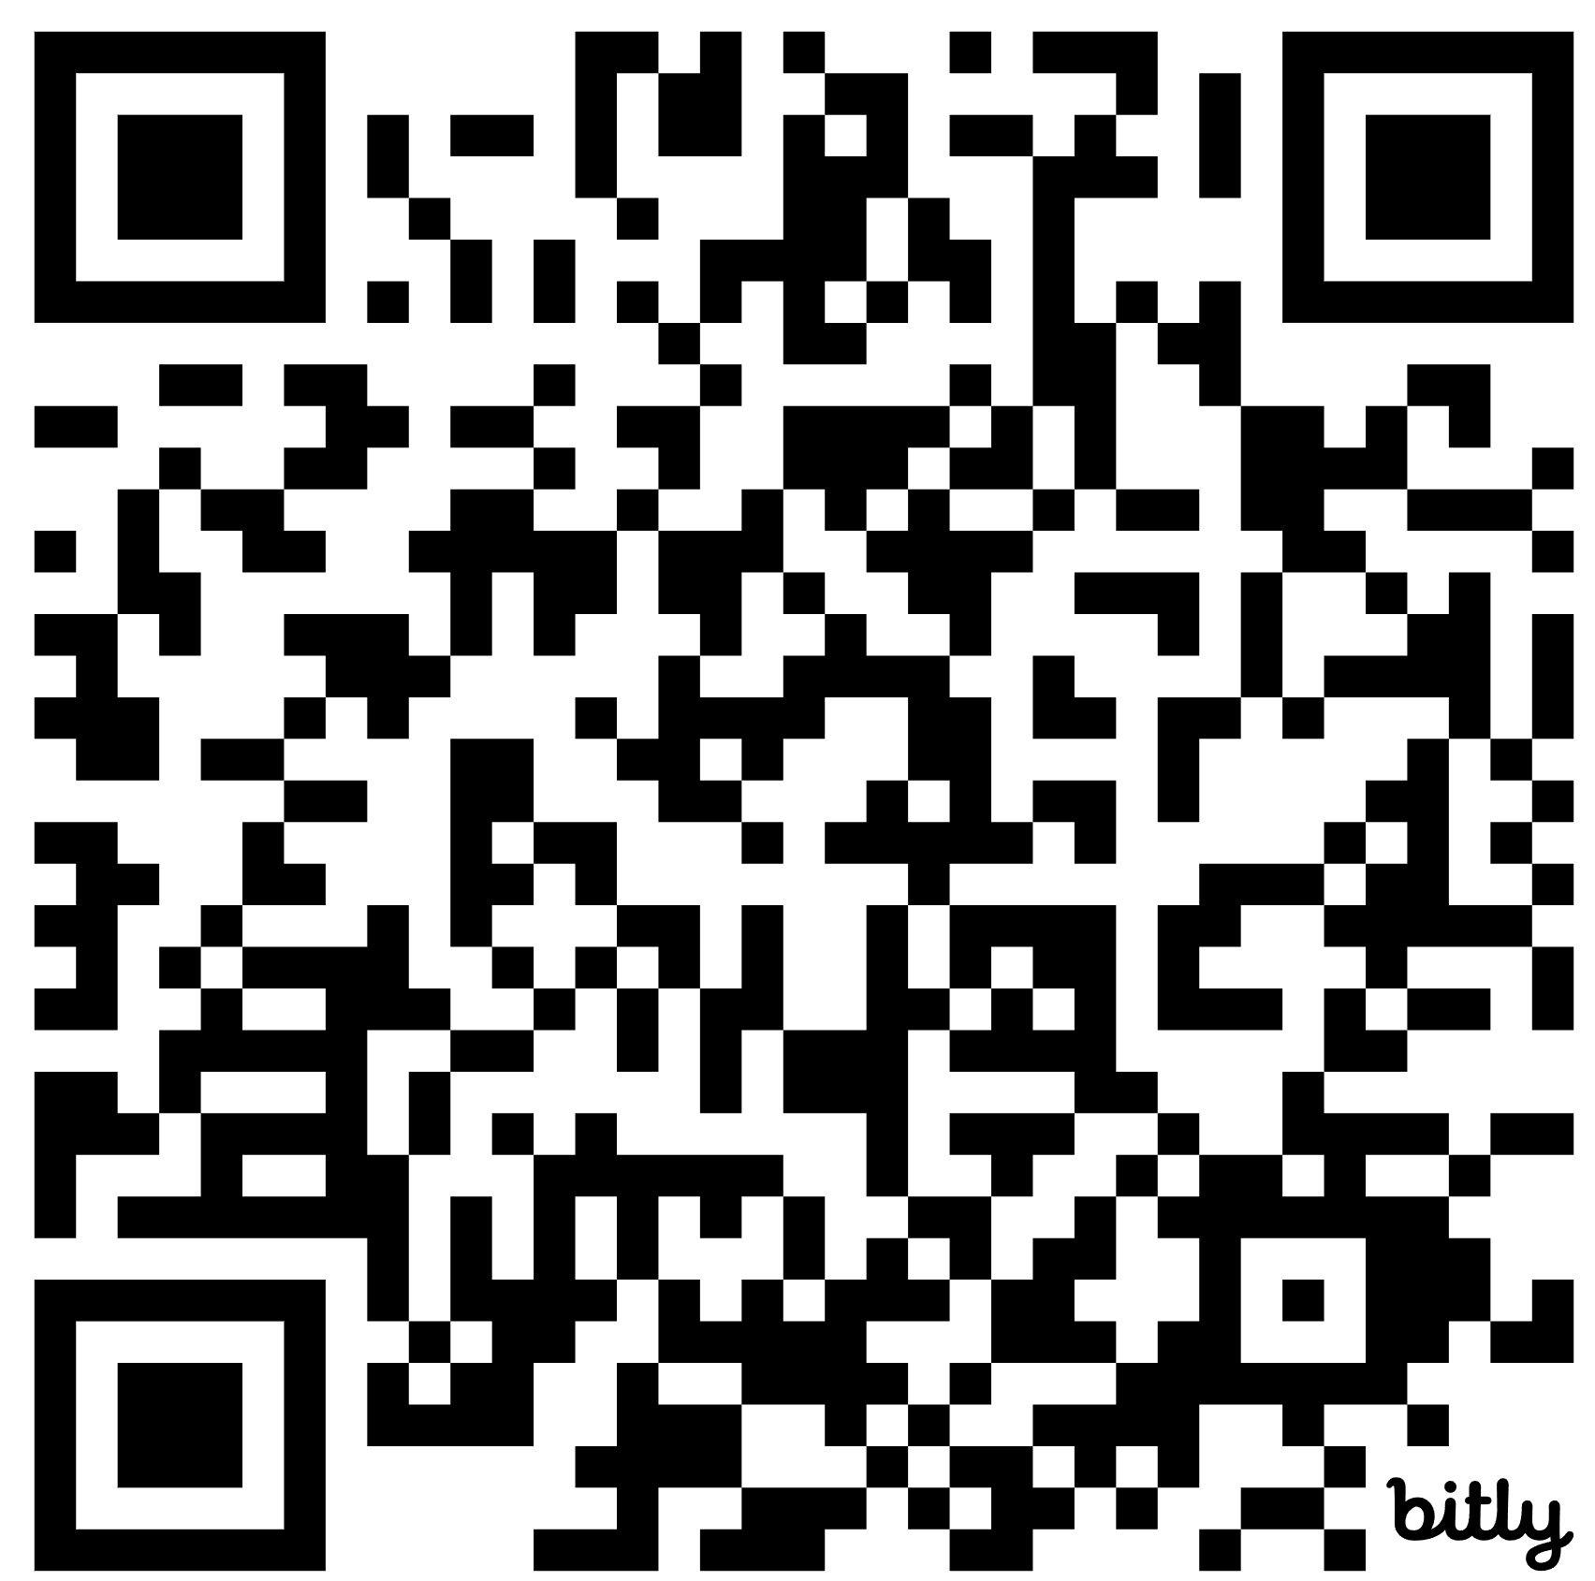
Presentation: https://bit.ly/sisconference25
https://bit.ly/sisconference25

Slide 21
Practical AI in Language Learning: Tools for Italian Studies
SIS Conference Digital Lab
University of Leeds
24th June 2025
Joe Dale
joedale@talk21.com

